Slide 1
Classification Advanced
Decision Trees
Mikołaj Nawojowski, Wojciech Nowak

Slide 2
AGENDA
Decision Trees introduction with a draft of used example
Assignment: Identyfing safe loans with decision trees
Binary Decision Trees introduction
Assignment: Implementing binary decision trees

Slide 3
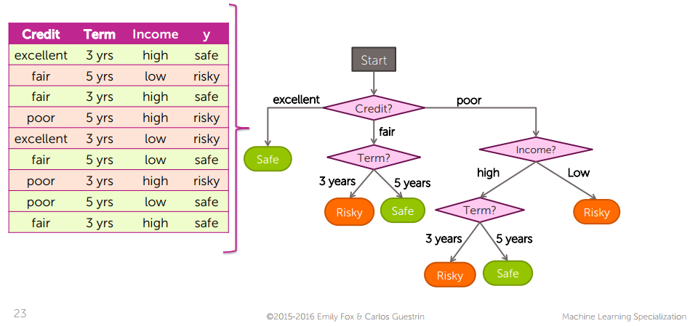
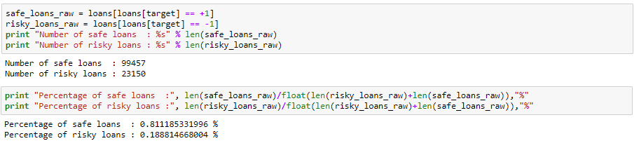
Decision tree
Notes:
Decision tree acts as classifier which have to classify samples into specific classes.
In this presentation and assigment we take as an exmaple loan application review system. This system analyse loans basing on many aspects such as term, type of ownership, reliability based on credit history (grade) and predicts if loan application is safe or not.
In our case, behind Intelligent loan application system we find decision tree.
We do it by traversing tree from the root and classyfing specific case into classes.
The answer is not always obvious as decision tree predicts answer with self-specific probability.
This probability is evaluated on each step of learning decision tree.
We also call it accuracy of the decision tree and it is connected with the parameter such as depth of the tree.
By depth of the tree we mean the number of its levels, for example tree presented above has got depth of 4
In this assignment we consider three depths of the trees and compare its accuracy:
Small 2 depth
Normal 6 depth
Big 10 depth
Our input data is set of rows with ~120 thousands applications.
As you can see over 80% of this applications has been classified as safe loans so the data is higly imbalanced.

Slide 4
Imbalanced Training Data
Why do we even care?
Imbalance is common
Accuracy Paradox
Great impact on results

Slide 5
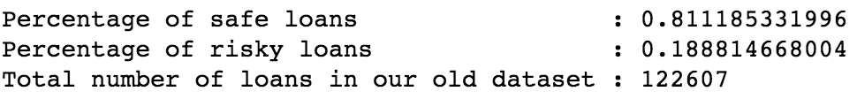
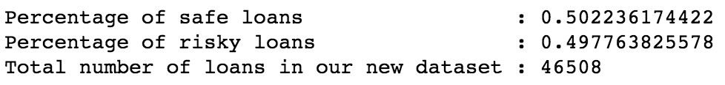
Subsample dataset to make sure classes are balanced
Imbalanced data
Balanced data
Notes:
There are a lot of other, more advanced techniques of balancing data but this one is the simpliest.

Slide 6
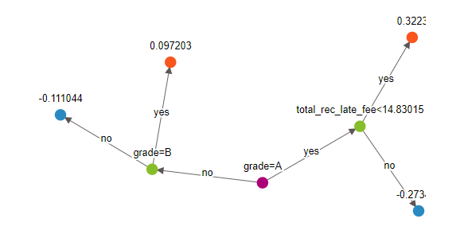
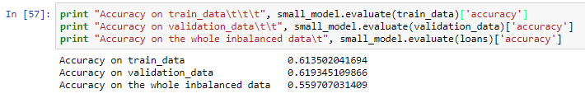
Accuracy of the 2 depth decision tree
Notes:
In assigment 1 we use built in functions to create decision_tree_classifier based on balanced data and analyse its accuracies.
'total_rec_late_fee', # total late fees received to day

Slide 7
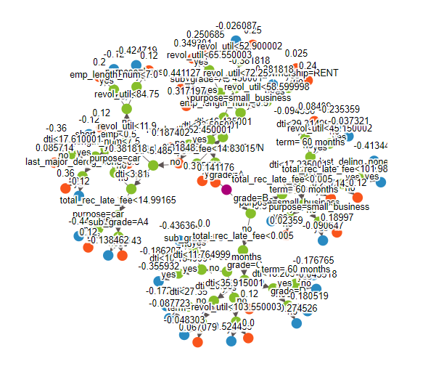
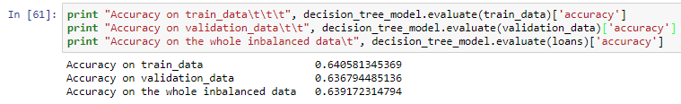
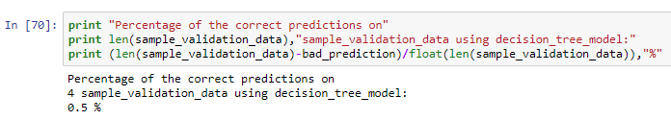
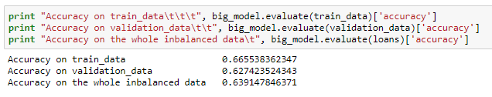
Accuracy of the 6 depth decision tree
ACCURACY OF THE 10 DEPTH DESICION TREE
Notes:
In this case we take into account another example.
We create tendetious set of 2 ‚safe’ and 2 ‚risky’ loan applications and check the tree accuracy analitycally.
As the 10 depth tree is quite complex and its visualisation is not readable I am not putting its here.

Slide 8
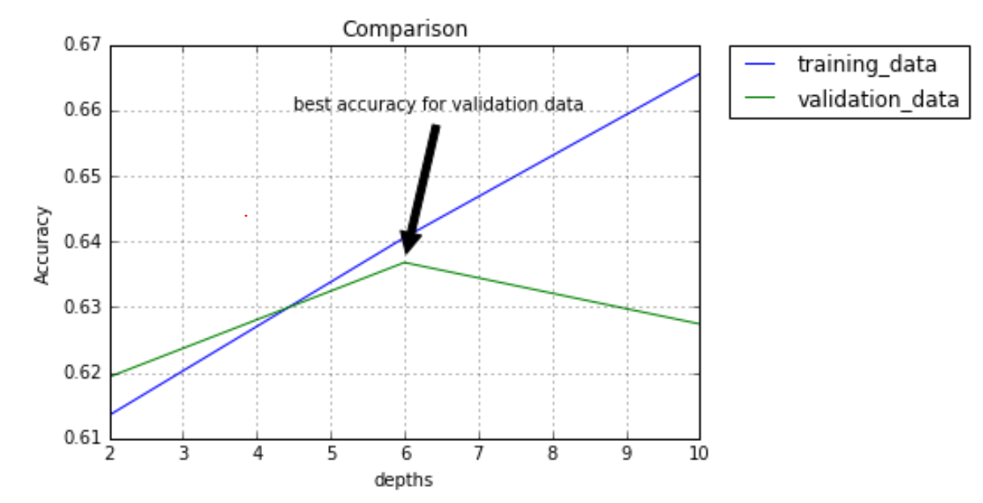
COMPARISON OF DIFFERENT TREE DEPTH
Notes:
As you can see the lowest prediction error we get with tree depth 10
But as we analyse the plot we see that the highest accuracy with train_data doesn’t meet with the highest accuracy on the validation data which is the point.
This sittuation we call overfiiting.
Tree depth 10 is overfitted as we get better accuracy on validation data with tree depth 6.
For this particular example the answer for the question what is the best depth of the clasifier tree is 6.

Slide 9
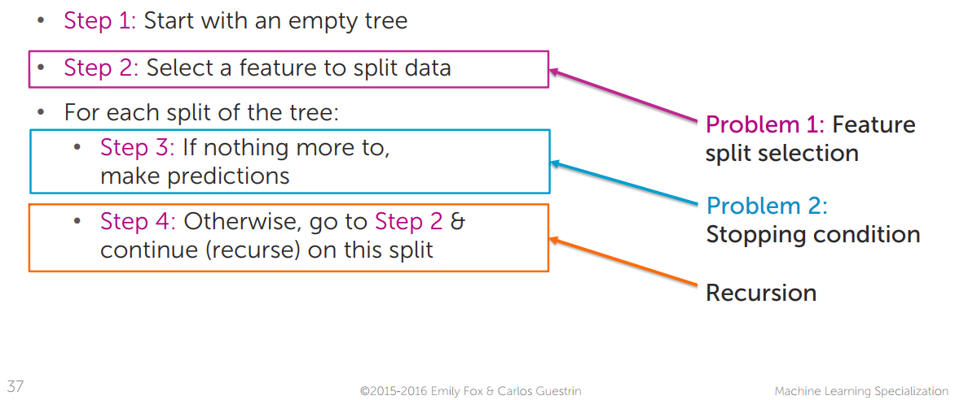
greedy decision tree learning

Slide 10
Binary decision tree

Slide 11
CHOOSing FEATURES
We will just be using 4 categorical features:
grade of the loan
the length of the loan term
the home ownership status: own, mortgage, rent
number of years of employment.

Slide 12
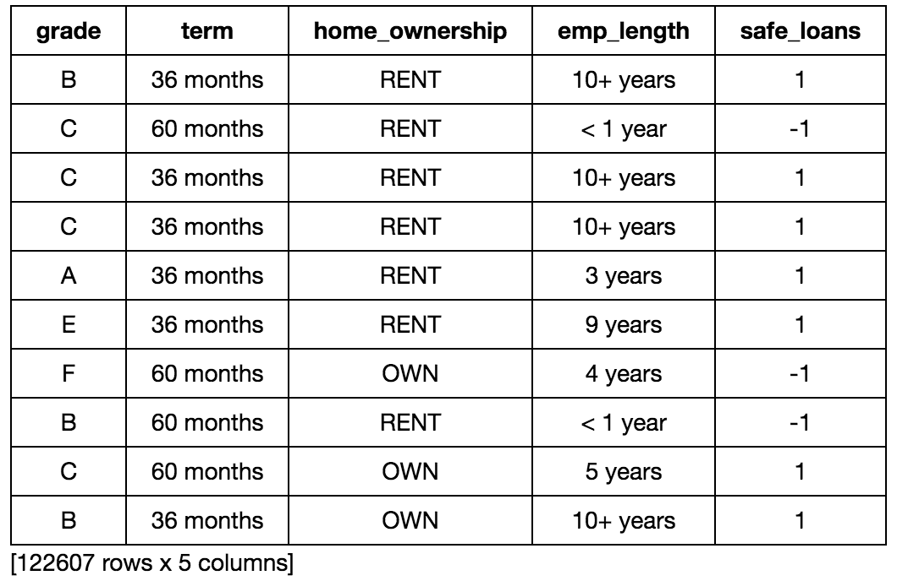
input data

Slide 13
How to build a binary tree?
Steps:
Subsample dataset to make sure classes are balanced.
Transform categorical data into binary features.
Train-test split.
Decision tree implementation:
Count number of mistakes while predicting majority class.
Pick best feature to split on.
Building the tree.
Making predictions with a decision tree.
Evaluating your decision tree.

Slide 14
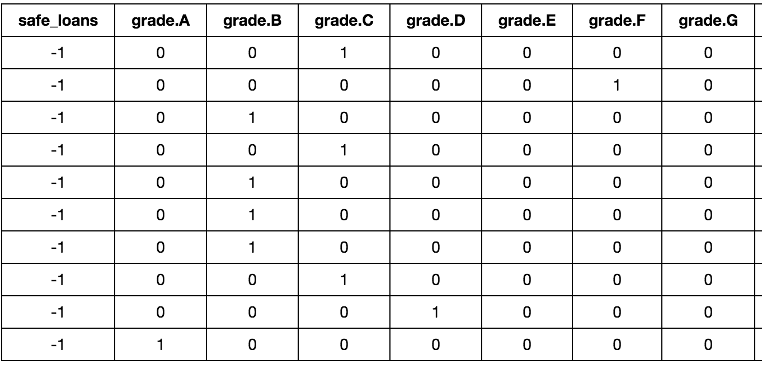
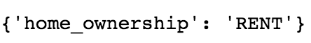
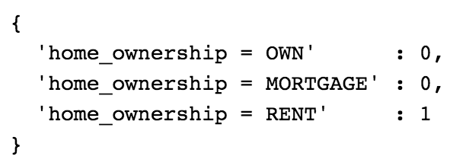
Transform categorical data into binary features

Slide 15
count number of mistakes while predicting majority class
Steps:
Step 1: Calculate the number of safe loans and risky loans.
Step 2: All the data points that are not in the majority class are considered mistakes.
Step 3: Return the number of mistakes.

Slide 16
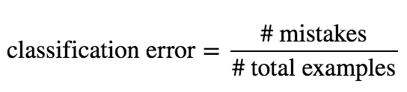
pick best feature to split on
Steps:
Step 1: Loop over each feature in the feature list
Step 2: Within the loop, split the data into two groups: one group where all of the data has feature value 0, and one group where all of the data has feature value 1
Step 3: Calculate the number of misclassified examples in both groups of data and compute the classification error.
Step 4: If the computed error is smaller than the best error found so far, store this feature and its error.

Slide 17
pick best feature to split on
Best feature is: term. 36 months!

Slide 18
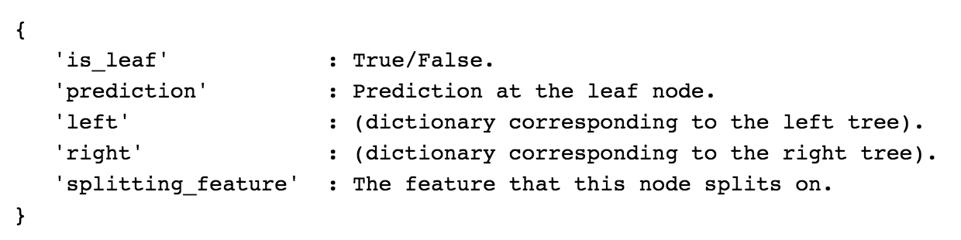
Building the tree
Stoping conditions:
All data points in a node are from the same class.
No more features to split on.
Max depth of the tree.

Slide 19
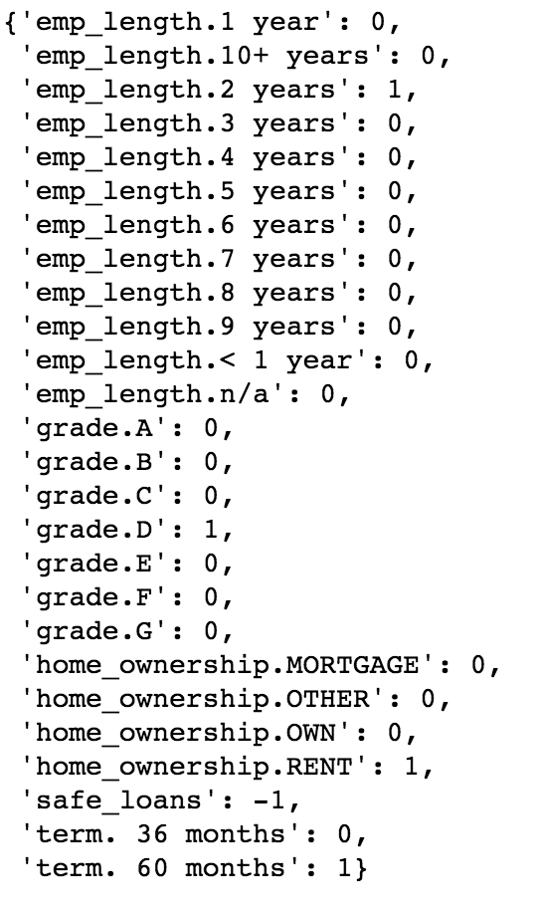
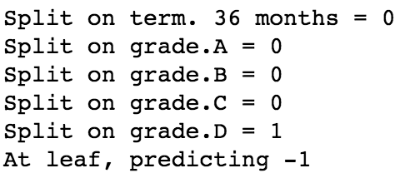
Making predictions with a decision tree

Slide 20
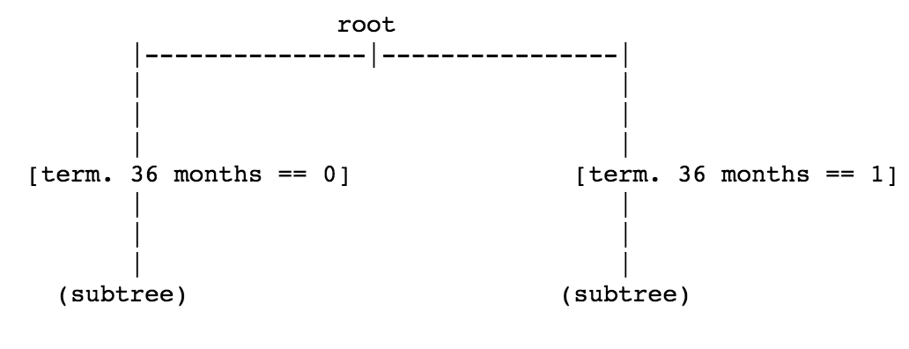
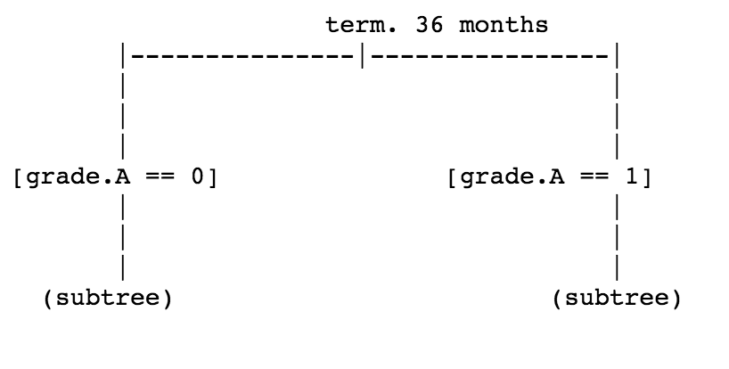
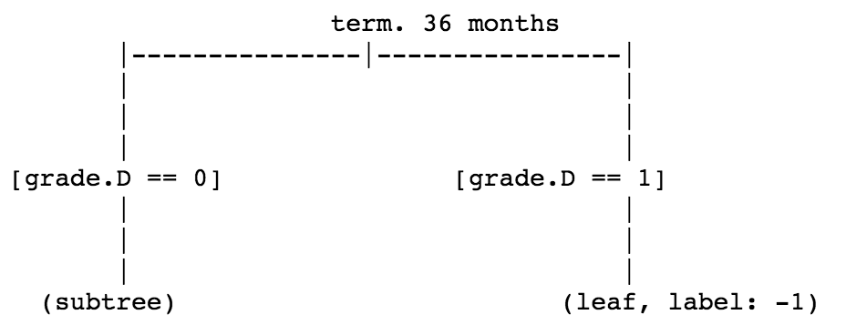
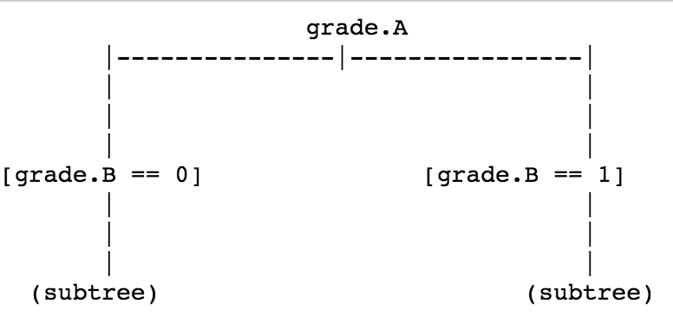
Evaluating decision tree

Slide 21
Summary
Increased DEPTH of the tree are not consistent with higher accuracy
Decision trees created using graphlab and our algorithm has similar accuracy
There is a lot of space for optimalisation for building binary decision tree
Notes:
Depends on split of data (balancing data)

Slide 22
Sources
Coursera Course: Machine Learning: Classification: week 3 Decision Trees module by University of Washington (Emily Fox. Carlos Guestrin)
https://stats.stackexchange.com/questions/12187/are-decision-trees-almost-always-binary-trees
http://www.ele.uri.edu/faculty/he/PDFfiles/ImbalancedLearning.pdf
https://machinelearningmastery.com/tactics-to-combat-imbalanced-classes-in-your-machine-learning-dataset/
https://sebastianraschka.com/faq/docs/decision-tree-binary.html
https://www.thefranchiseking.com/franchise-ownership-doesnt-have-to-be-a-risky-endeavor

Slide 23
Thank you for your attention!

